Slide 1
Beer and Brewery Analysis
Prepared for: Budweiser Executive Team
Analysis by: Andrew Yule

Slide 2
Data Used / Key Terms
Data
Beers.csv (2,410 observations)
Summary of beer names, characteristics, and styles from across the country
Breweries.csv (558 observations)
Summary of brewery locations across the country
Key Terms
ABV
Alcohol by Volume
IBU
International Bitterness Units
Note: IBU is missing for 42% of the data supplied

Slide 3
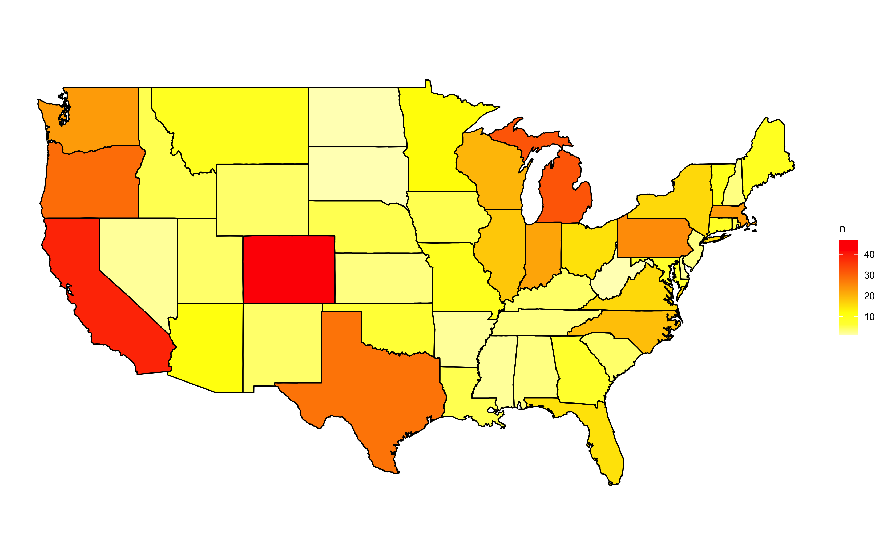
Breweries Across the States
Top 5 states:
Colorado (47)
California (39)
Michigan (32)
Oregon (29)
Texas (28)
Bottom 5 states:
DC (1)
North Dakota (1)
South Dakota (1)
West Virginia (1)
Arkansas (2)
Top 5 make up 32% of all breweries
Except for Colorado, the top 5 states by number of breweries are all located on coastlines
Opportunities for Budweiser to invest in Midwest and Southern portions of the United States

Slide 4
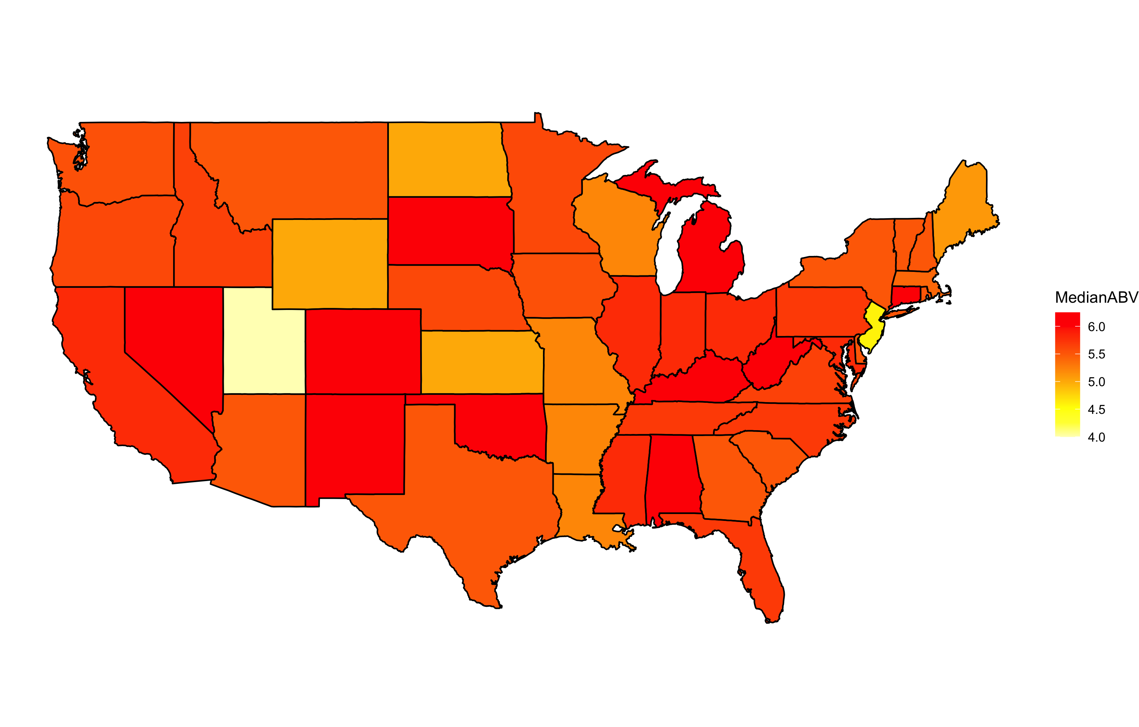
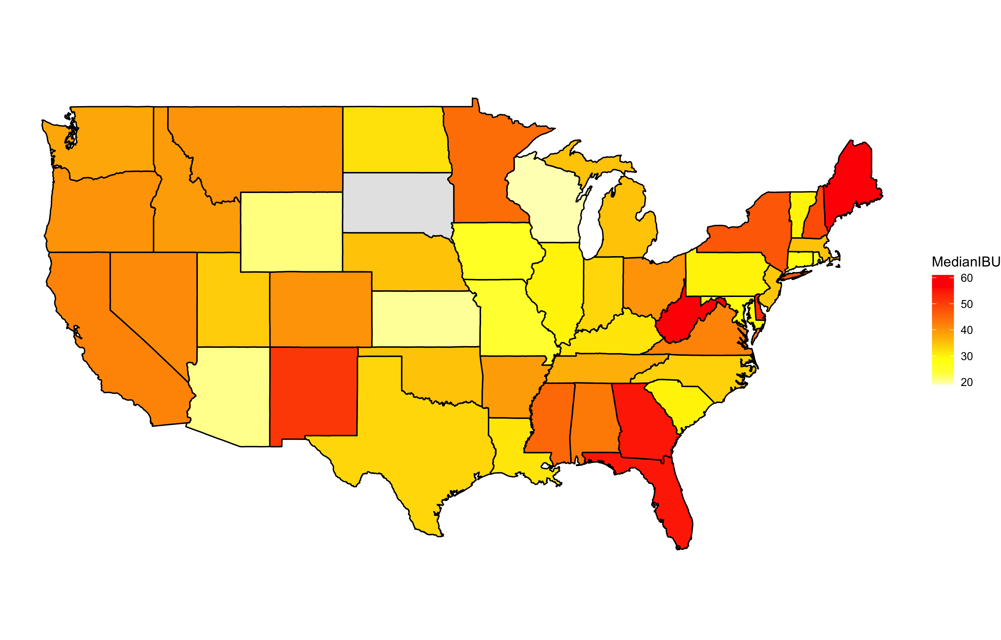
How does ABV and IBU Vary by State?
Median ABV does not vary much across the states
(4% – 6.25%)
Utah allows 4% beer to be sold in grocery stores
Median IBU has much higher variability across states
(19 – 61)
Eastern states have larger preference for higher IBU beers

Slide 5
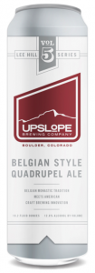
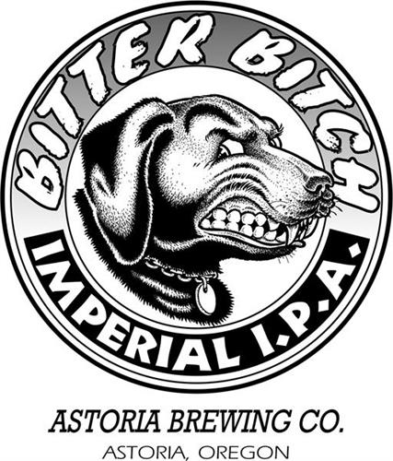
Overall Maximum ABV and IBU
Max Overall ABV
Lee Hill Series Vol. 5 - Belgian Style Quadrupel Ale
Upslope Brewing Company
Colorado
ABV = 12.8%
Max Overall IBU
Bitter B*tch Imperial IPA
Astoria Brewing Company
Oregon
IBU = 138

Slide 6
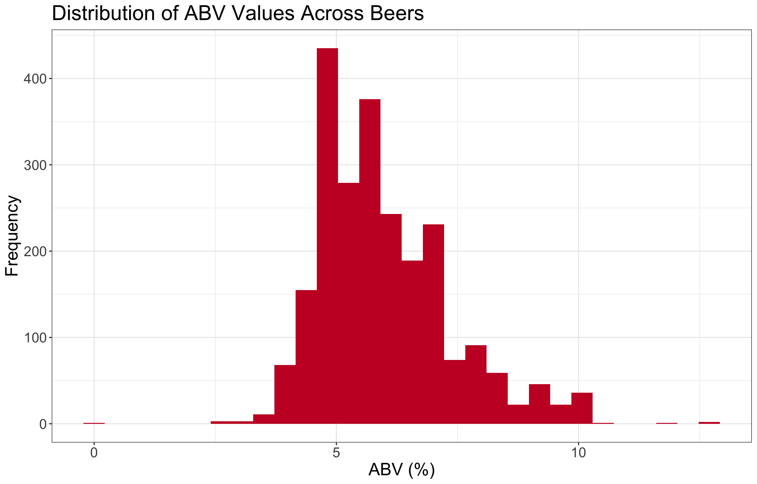
Distribution of ABV
Parameter | Value
Minimum | 0.001
1st Quartile | 0.050
Median | 0.056
Mean | 0.059
3rd Quartile | 0.067
Max | 0.128
Data is skewed to the right
There are a number of very high alcohol beers which increase the average ABV across the data

Slide 7
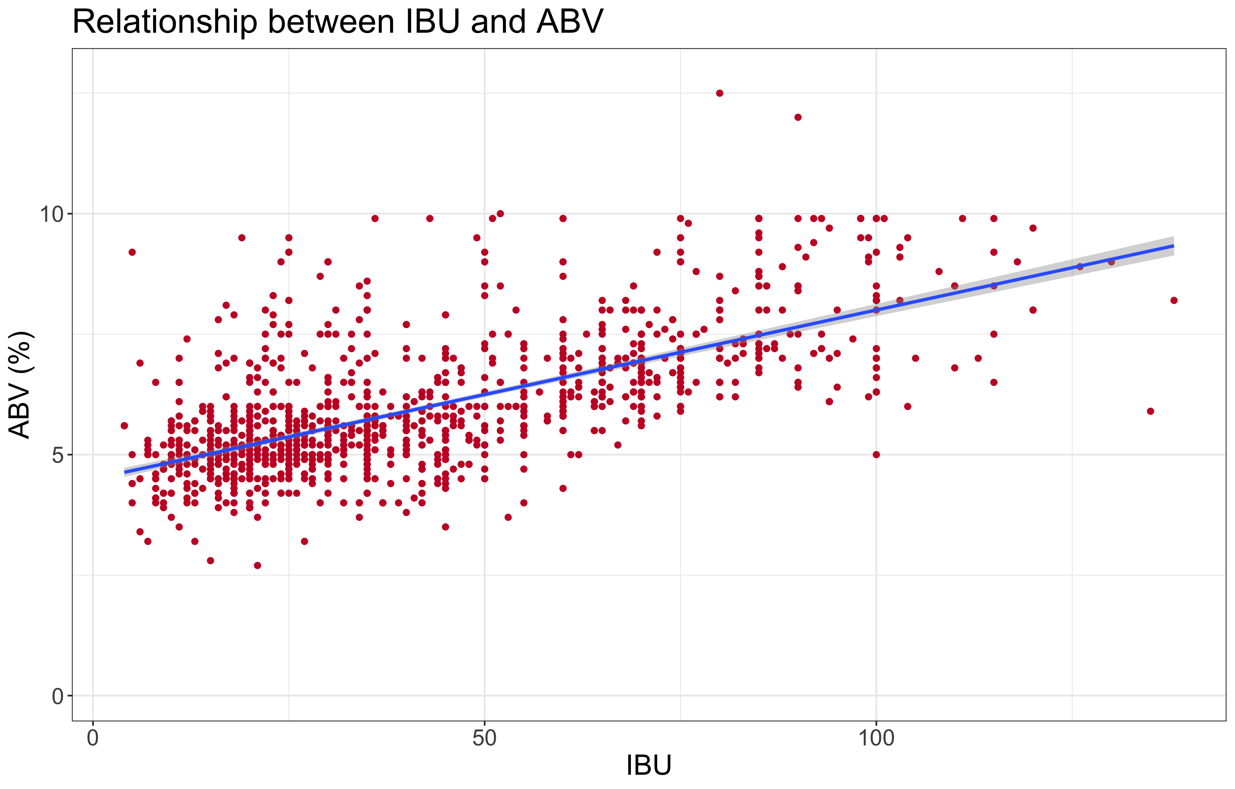
Relationship Between IBU and ABV
The relationship between IBU and ABV was found to have a positive correlation coefficient of 0.67
Indicates that more bitter beers generally have higher alcohol contents

Slide 8
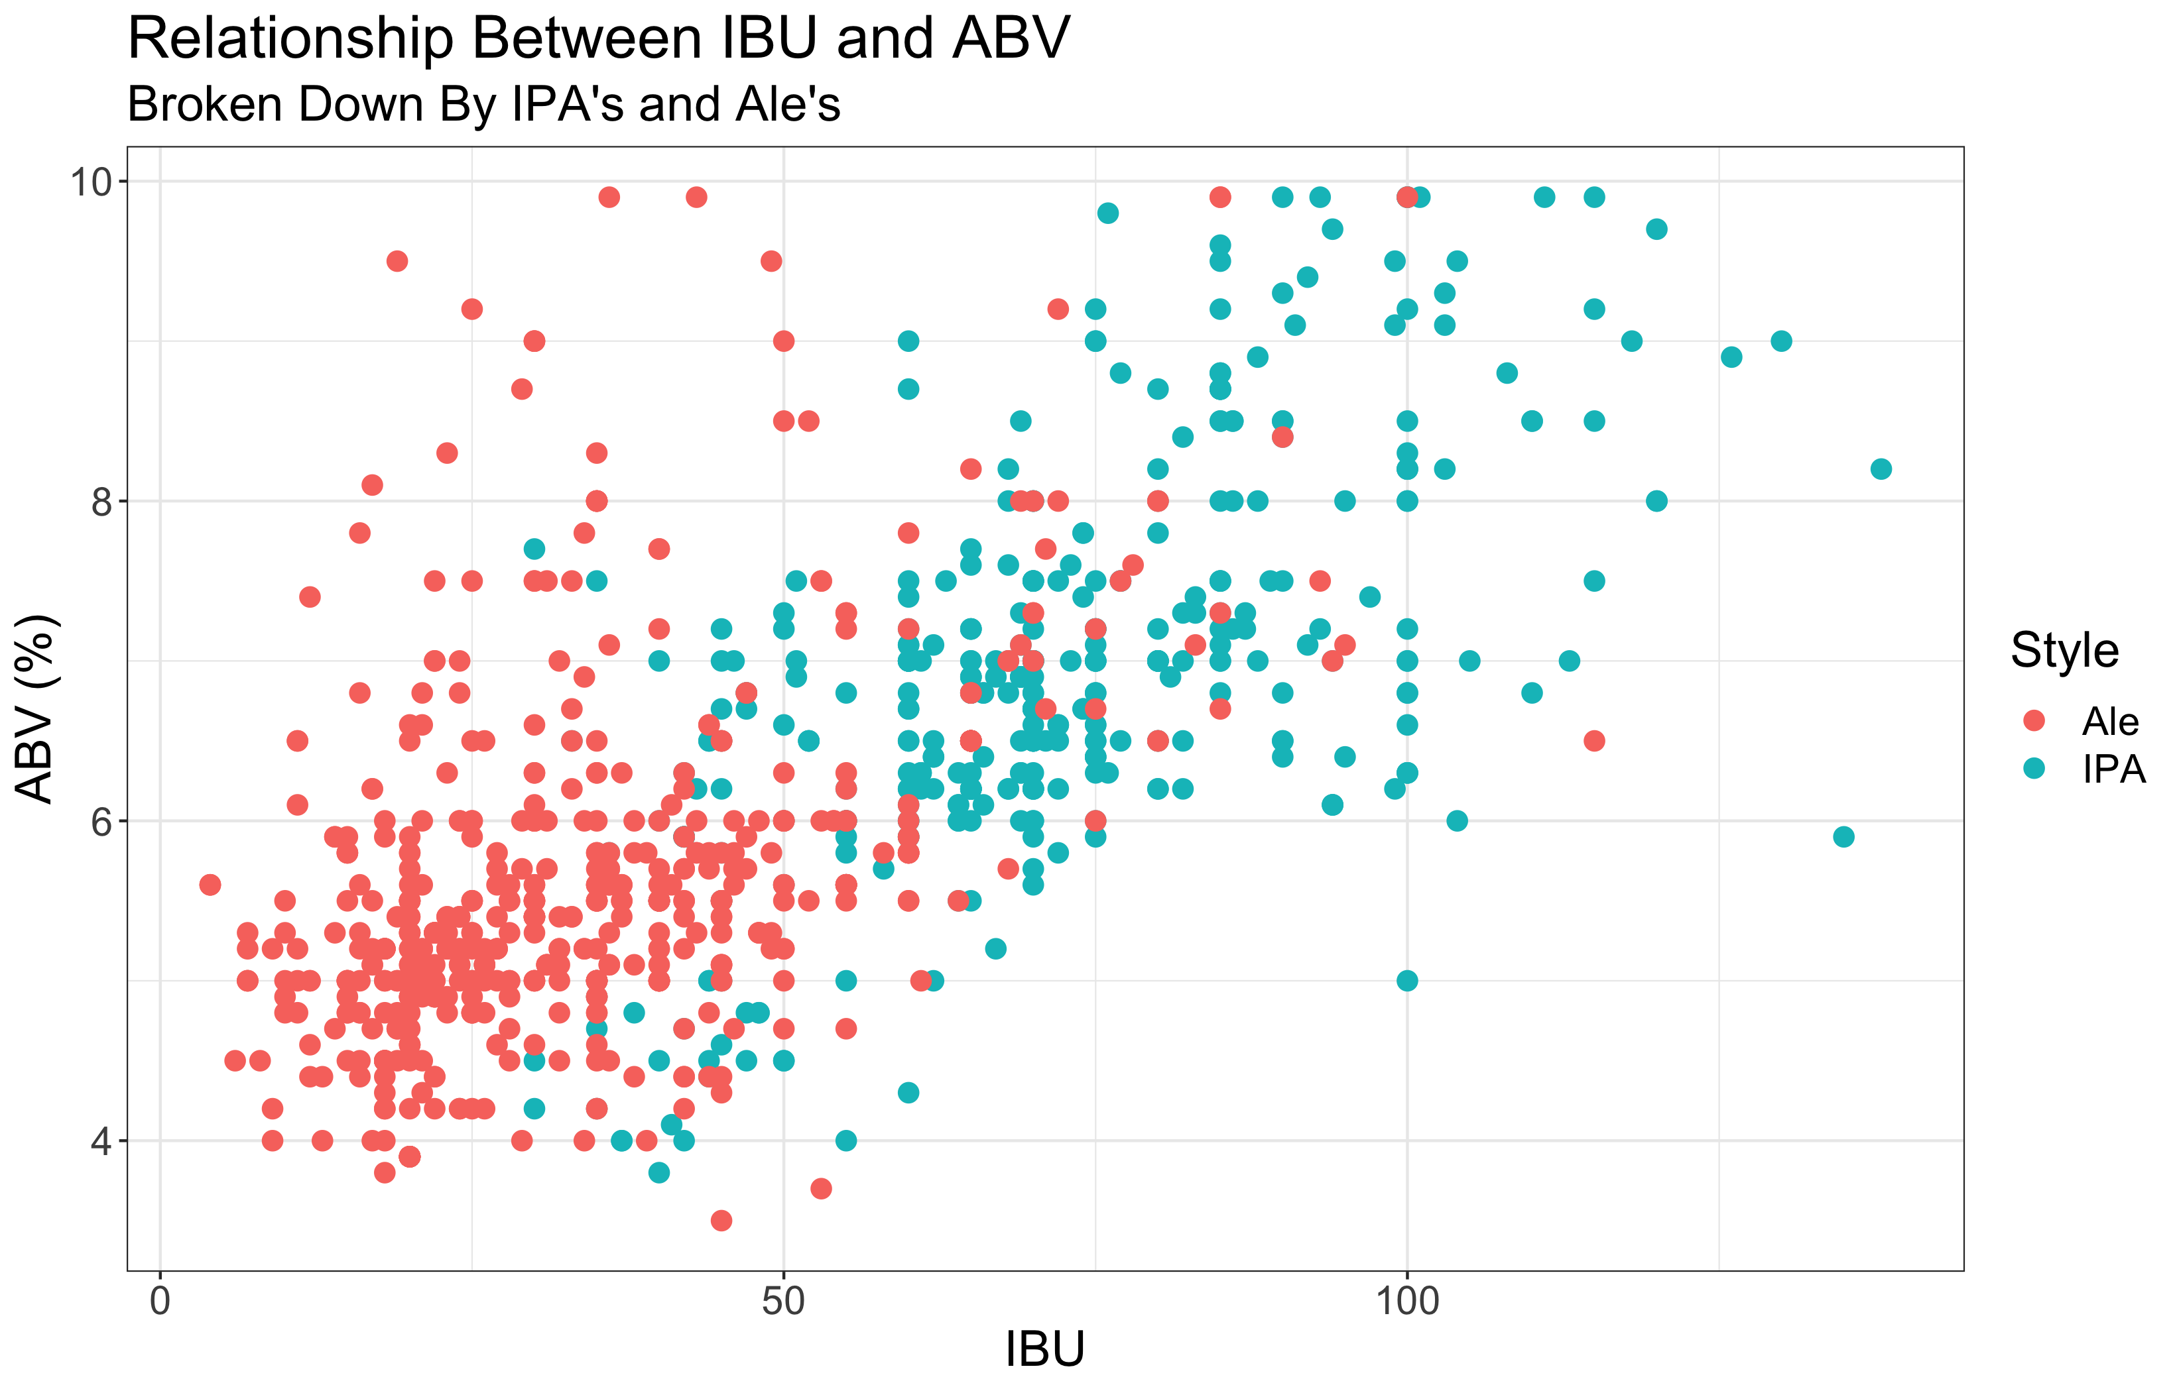
IPA’s and Ale’s
Visual evidence that IPA’s and Ale’s have very distinct IBU and ABV values
Classification techniques were used to test this theory

Slide 9
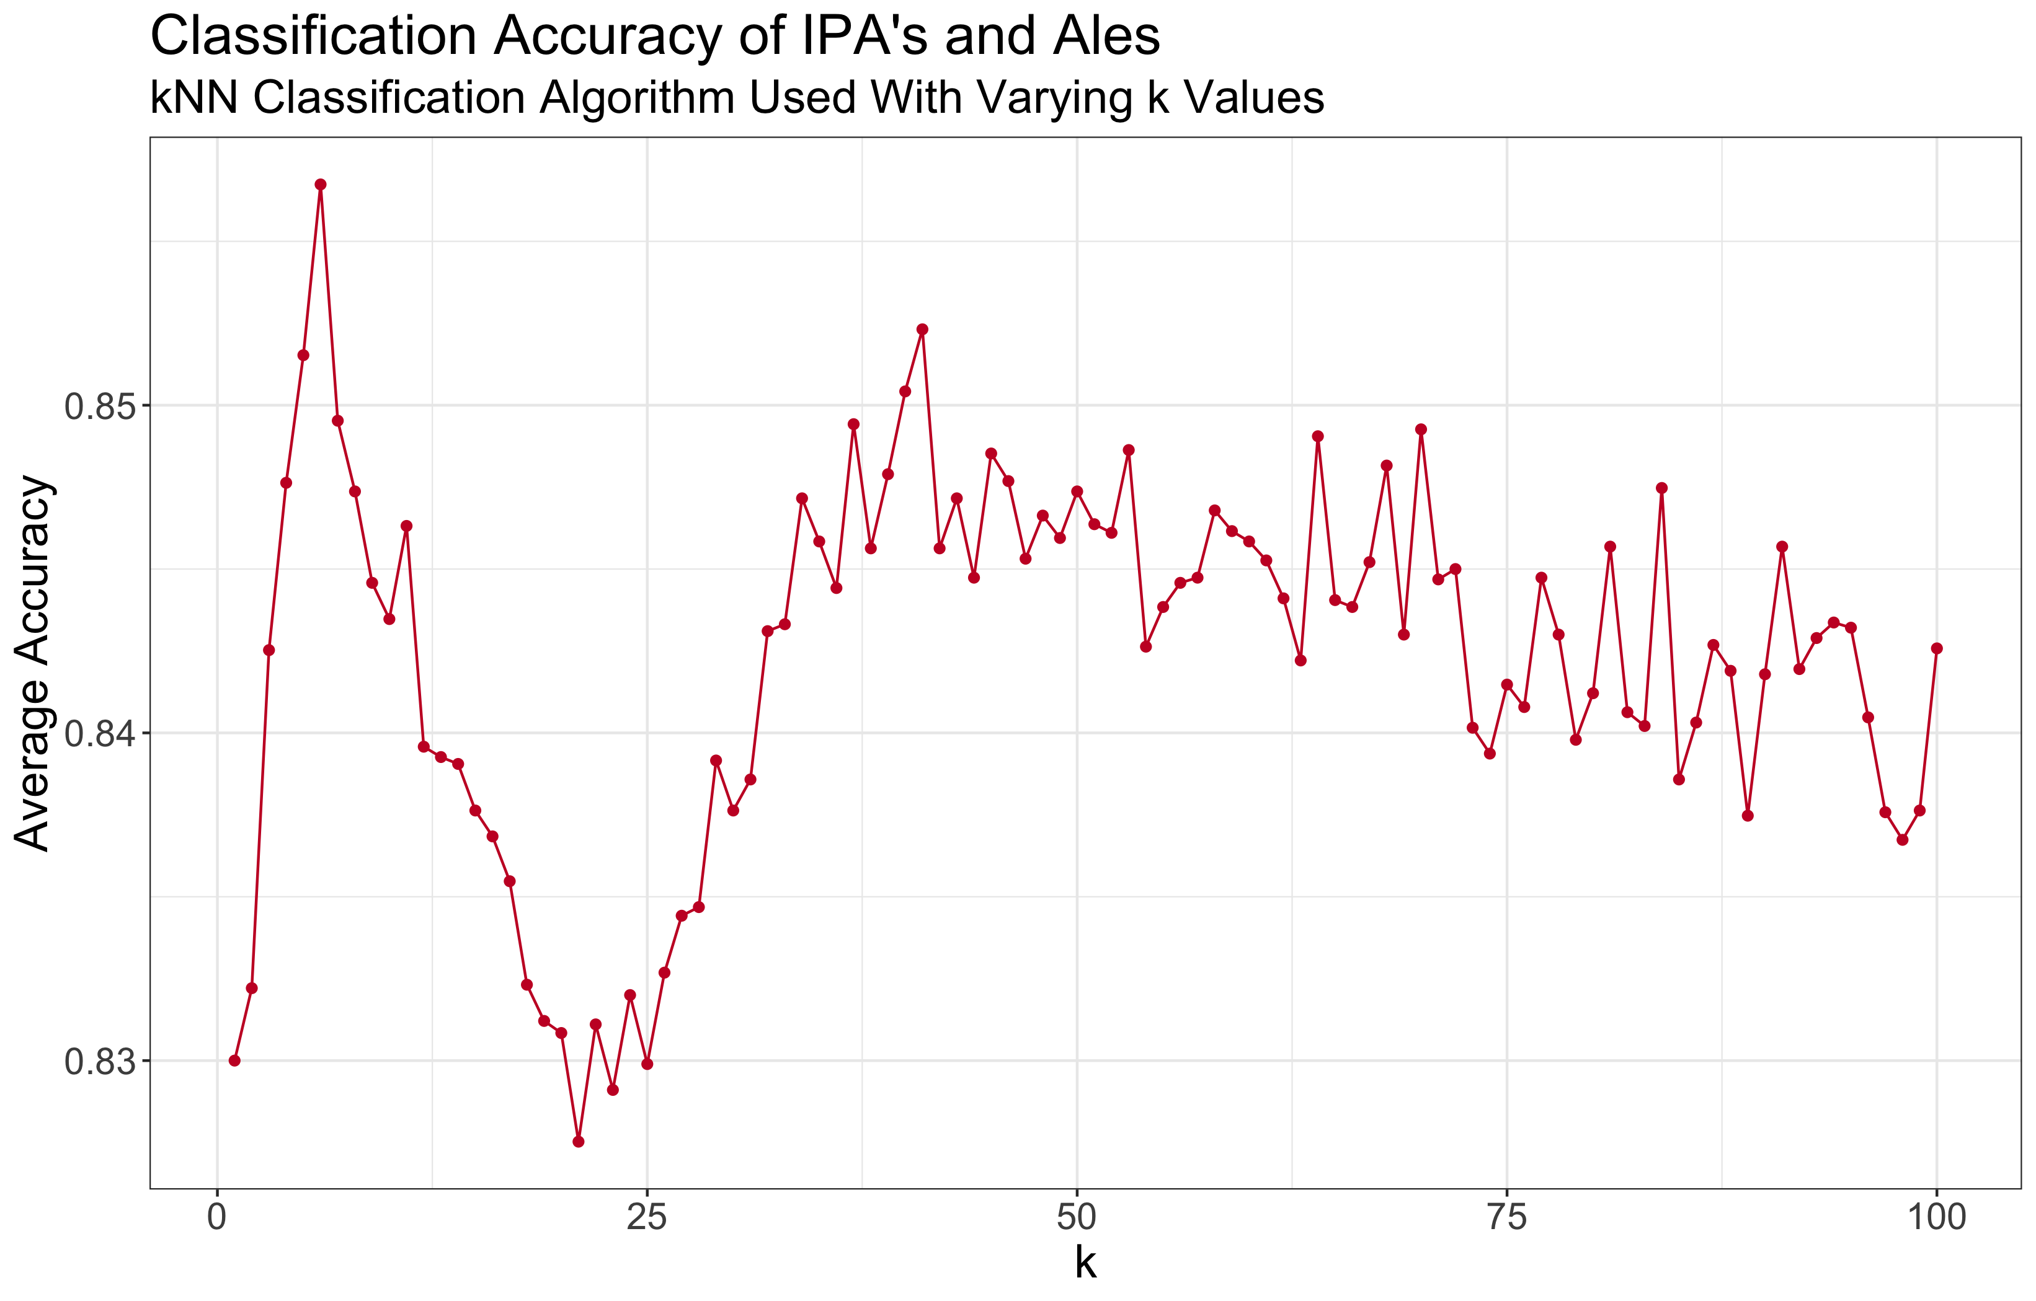
IPA’s and Ale’s
Typical classification accuracy exceeds 84%
Confirms ability to differentiate IPA’s and Ale’s from one another based solely on IBU and ABV
Peak accuracy exceeds 85% with optimal k value of 5

Slide 10
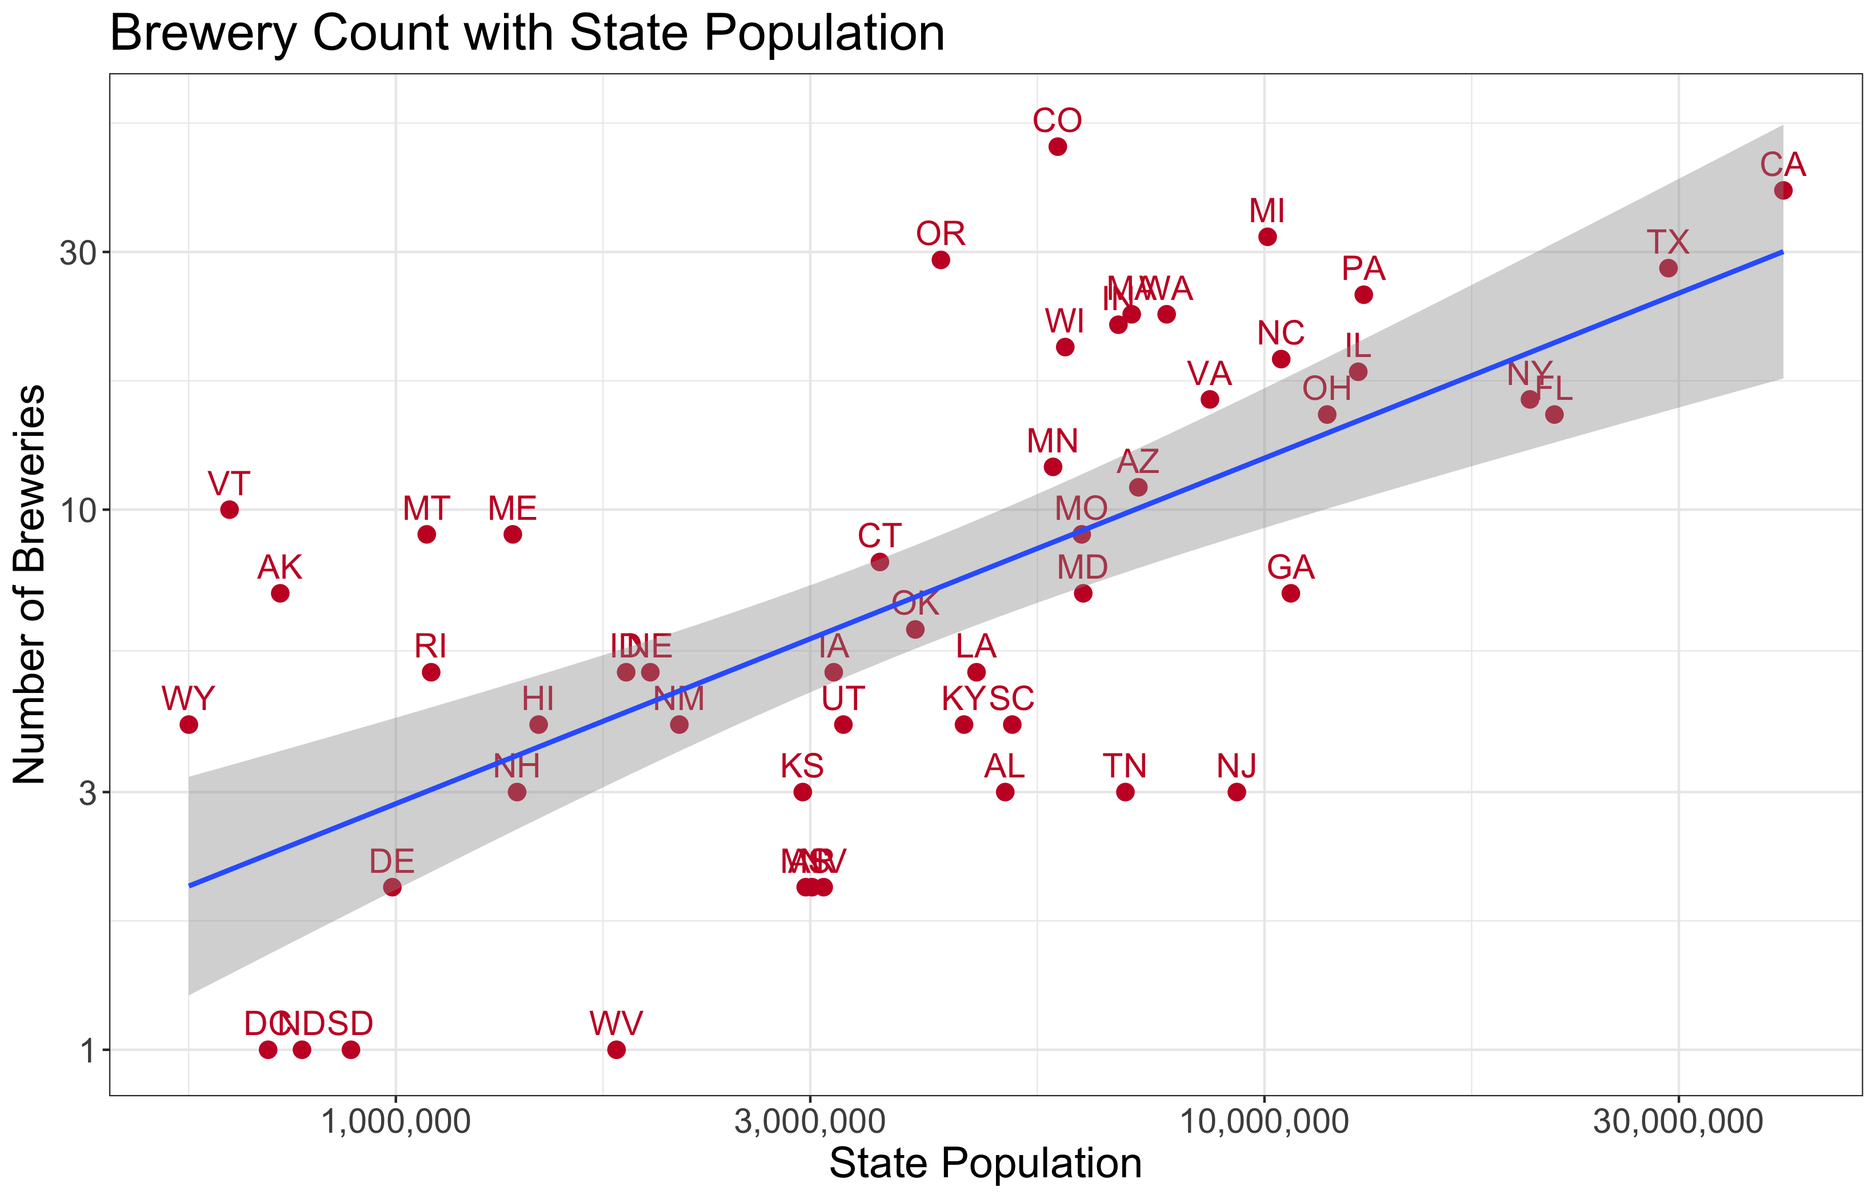
Where to Invest in More Breweries?
States are more saturated with breweries
States circled have high populations and relatively low number of breweries
States are less saturated with breweries

Slide 11
Key Takeaways
5 states make up over 31% of the breweries across the nation
Average ABV generally varies little across the states (~5% - 6%)
In contrast, IBU varies much more broadly (~19 – 61) with Eastern states preferring more bitterness
ABV is expected to increase as IBU increases and this relationship is particularly strong in IPAs and Ales where high accuracy classification can be achieved based solely on these parameters
As Budweiser looks to invest in the creation of small breweries across the nation, states such as Georgia, New Jersey, Tennessee, Alabama, and South Carolina represent large populations that may be undersaturated with breweries

Slide 12
Thank You

